Slide 1






TEAM TESLA
AKSHARA SINGH
SHUBHAM PATEL
POOJA HIREMATH
RISHIKA DAWKAR
SAKSHAM SINGH

Slide 2

BACKGROUND
Tesla is an American automotive and energy company based in California
The company specializes in electric car manufacturing and solar panel manufacturing
Tesla Motors is the second oldest publicly listed American Automaker
Tesla’s stock price surged on Monday, pushing the company’s value above $50 billion for the first time. The markets now value Tesla more highly than Ford at $45 billion.
Wall Street sees Tesla, not classic companies like Ford, as the future of cars.
with 245,240 units delivered and a market share of 12% of the plug-in segment sales. Tesla vehicle sales in the U.S. increased by 280% from 48,000 in 2017 to 182,400 in 2018, and globally were up by 138% from 2017. However, Tesla has never had a profitable year.
After 10 years in the market, Tesla ranked as the world's best selling plug-in passenger car manufacturer in 2018
Tesla is aiming to be the Apple of the car business
Tesla Stock Rises After Cybertruck Orders Surpass 200,000

Slide 3
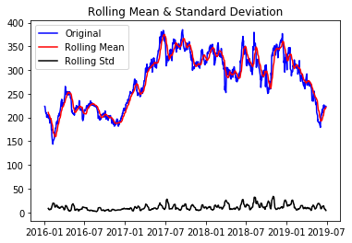
STATISTICAL FEATURES
Mean – average returns over a certain period.
Standard deviation measures volatility and determines what performance of returns can be expected.

Slide 4
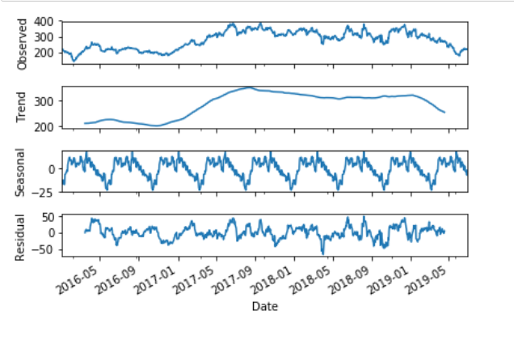
DECOMPOSITION OF TIME SERIES
OBSERVED VALUES
TREND-The increasing or decreasing value in the series.
SEASONALITY-The repeating short-term cycle in the series.
RESIDUAL-The random variation in the series.

Slide 5


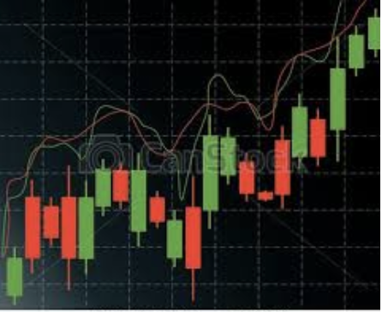
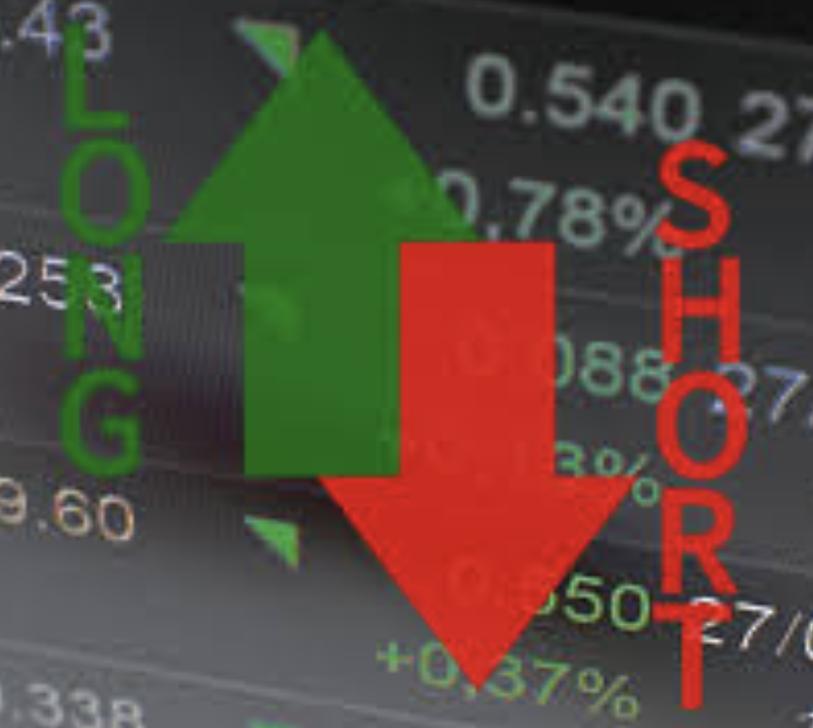
Trading Strategies for Tesla
Buy-and-Hold
[Base Strategy]
Buy-and-Hold
[Long-only]
Day-trading
Long-Short

Slide 6
SAMPLE PERIOD
TRAIN PERIOD = 620 days
TEST PERIOD = 250 days
Signal BUY:
Initial Capital = 10,000$
Number of shares N = Initial_Capital / Price at the Signal
Holding = N* Price at the Signal
Cash = Initial Capital – Holding (Remaining balance)
Total_Value = Cash + Holding
Signal SELL:
Cash = (Remaining balance + Number of shares*Price)
Number of shares N = 0
Holding = 0
Total_Value = Cash
BACK-TESTING STRUCTURE
Calculate the return using percent change of the Total_Value for calculating the Sharpe Ratio

Slide 7




KALMAN FILTER
The prediction step:
the next state of the system is predicted given the previous measurements
The update step:
the current state of the system is updated based on the errors.
FAMA FRENCH
Market risk
The outperformance of small-cap companies relative to large-cap companies, and
The outperformance of high book-to-market companies versus low book-to-market companies.
GARCH
GARCH is appropriate for time series data where the variance of the error term is serially autocorrelated following an autoregressive moving average process.
The first is to estimate best-fitting autoregressive model.
The second is to compute autocorrelations of the error term. The third step is to test for significance.

Slide 8
KALMAN FILTER
 | Basic Strategy
Total returns | 7206.72$
Sharpe Ratio | -0.36
Day Trading

Slide 9
Day Trading
Investment = 10,000$
 | Basic Strategy
Total returns | 7206.72$
Sharpe Ratio | -0.36

Slide 10
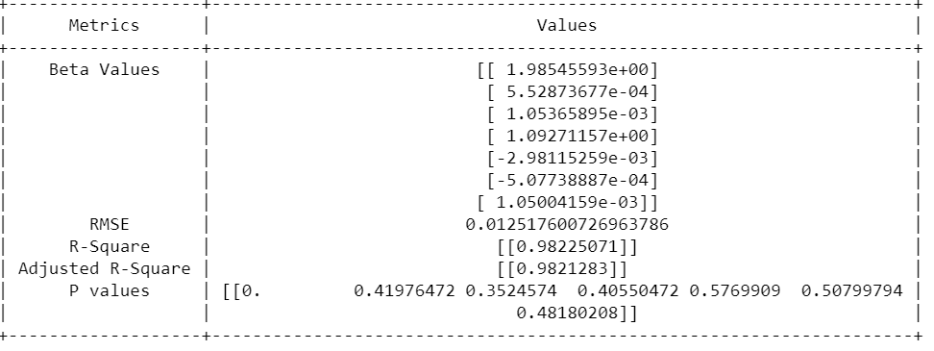
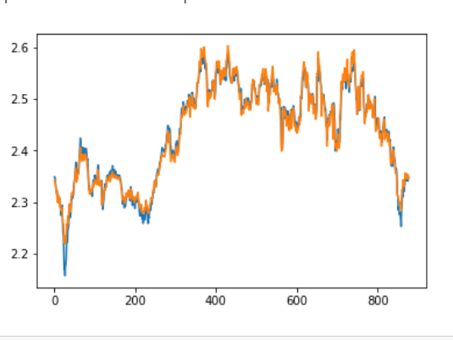
FAMA FRENCH-3 FACTOR MODEL X_ALL = 'High', 'Low', 'RF','Mkt-RF', 'SMB', 'HML’ Y_ALL = 'logClose'

Slide 11
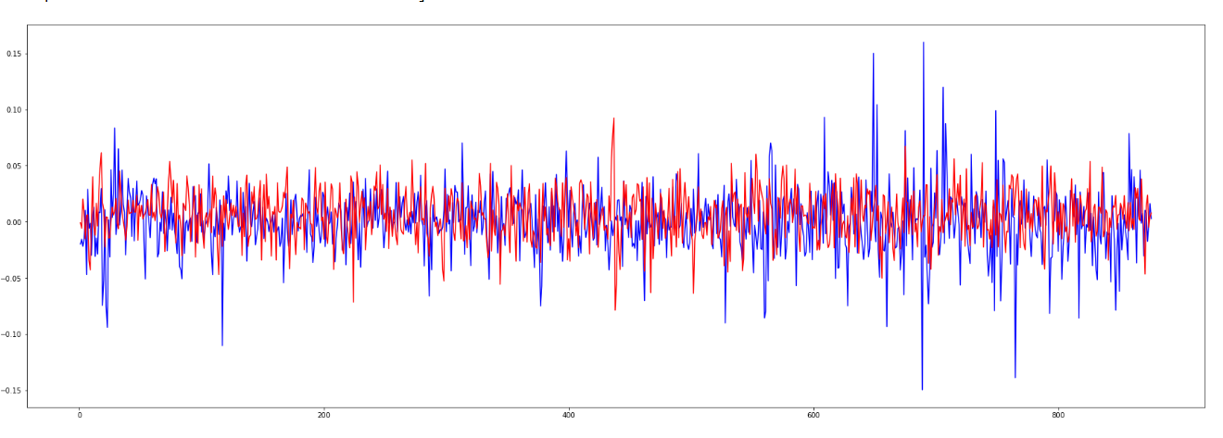
GARCH MODEL

Slide 12
PCA+FAANG
PCA is used to reduce the number of features without the loss of too much information along with FAANG
PCA+ADS
ADS focuses on economic indicators blend & high- and low-frequency information and stock and flow data
Multiple Linear Regression
Statistical technique that uses several explanatory variables to predict the outcome of a response variable

Slide 13
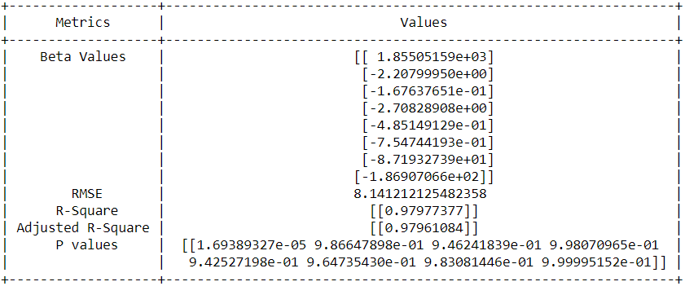
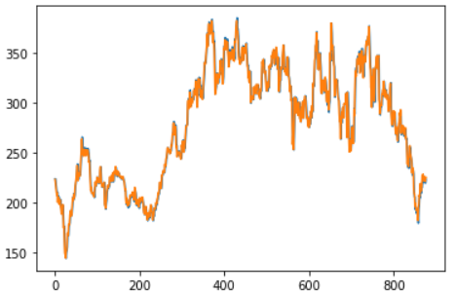
Principal Component Analysis + FAANG + ADS Index
X= 'AAPL’, 'AMZN’, 'FB’, 'GOOGL’, 'NFLX’, 'ads Index’, 'PC1' Y= 'Close'

Slide 14
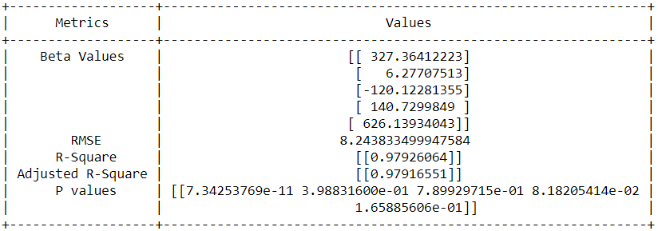
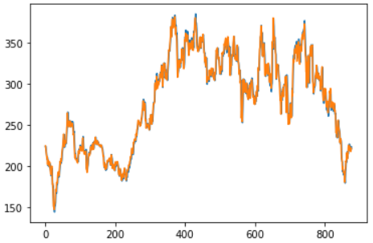
Principal Component Analysis + ADS Index
X= 'PC1’, 'PC2’, 'PC3’, 'ads Index’
Y= 'Close'

Slide 15
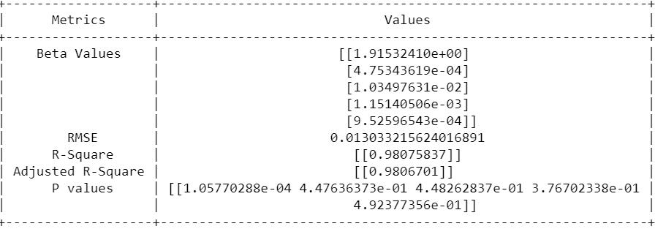
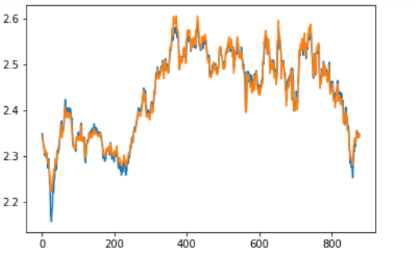
Multiple Linear Regression
X= 'High’, 'logVol’, 'Low’, ‘Ads Index’
Y= logclose

Slide 16
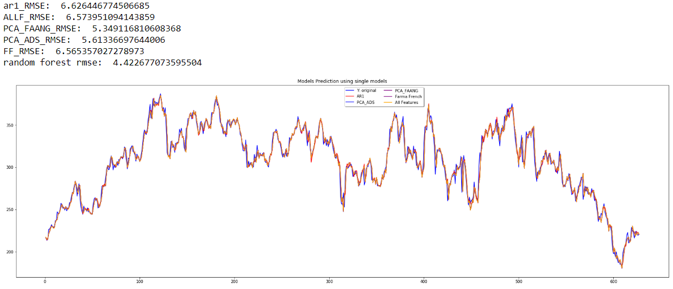
Random Forest

Slide 17
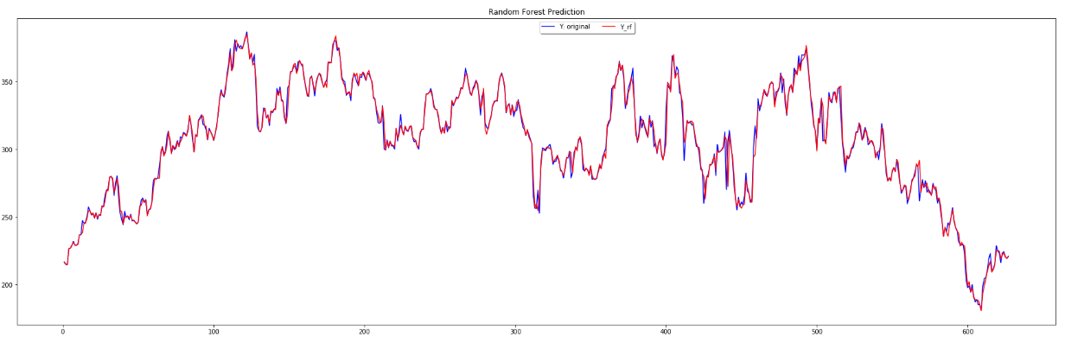
Random Forest Ensemble

Slide 18
TRADING STRATEGIES
2.Long Short
Long/short equity is an investing strategy that takes long positions in stocks that are expected to appreciate and short positions in stocks that are expected to decline.
Why are we using it?
This strategy seeks to minimize market risk while profiting from stock gains in the long positions, along with price declines in the short positions.
3. Buy and Hold
Buy and hold is a passive investment strategy in which an investor buys stocks (or other types of securities such as ETFs) and holds them for a long period regardless of fluctuations in the market.
Why are we using it?
tax benefits because the investor can defer capital gains taxes on long-term investments.
1.DAY TRADING
Day trading is defined as the purchase and sale of a security within a single trading day.
Why day trading for Tesla?
The stock is in an UPTREND.
Every dip gets bought up

Slide 19
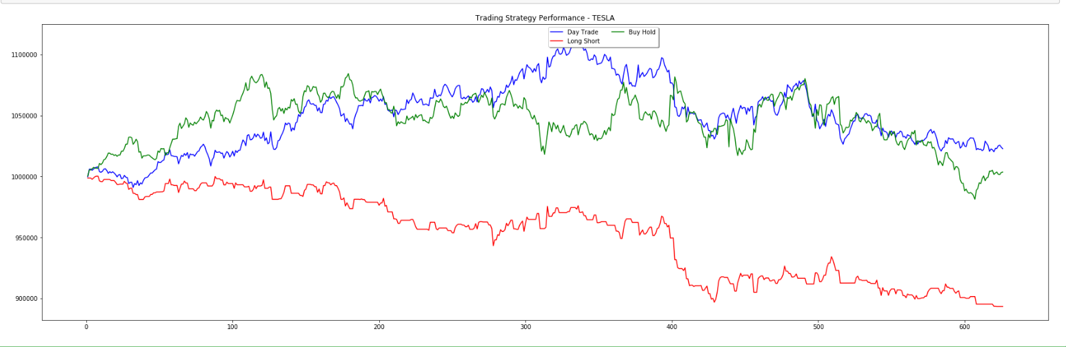
Trading Strategies Performance

Slide 20
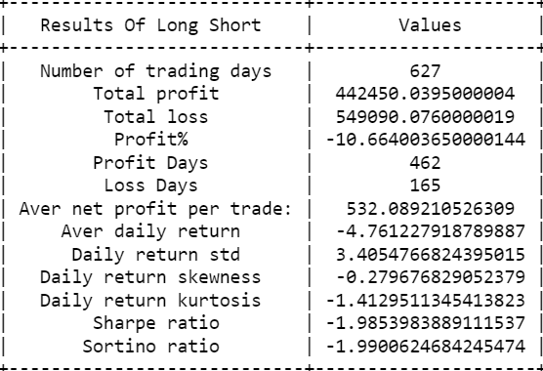
Long Short

Slide 21
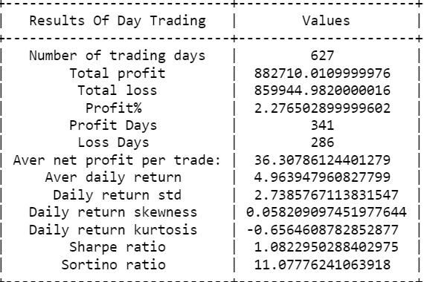
Day Trading

Slide 22
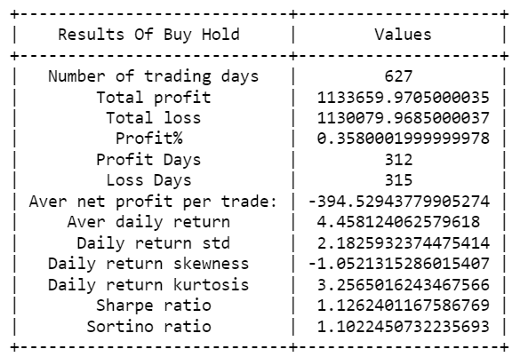
Buy And Hold

Slide 23




Technical Indicators
Momentum
Trend
Volatility
Volume
MACD
MACD
Bollinger
Bands
Bollinger
Bands
Keltner
Channel
On Balance
Volume

Slide 24
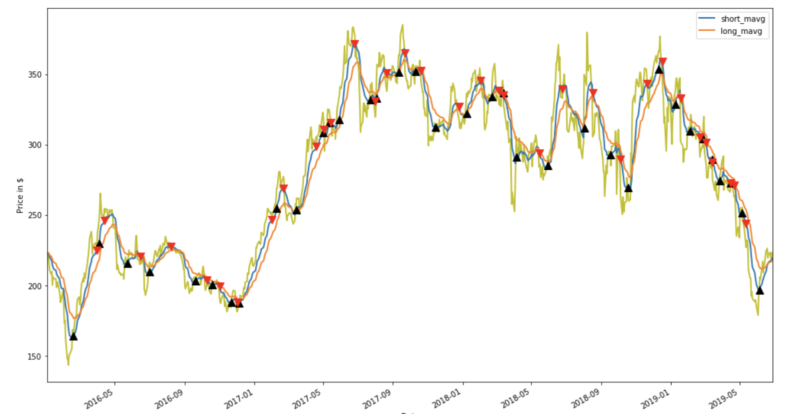
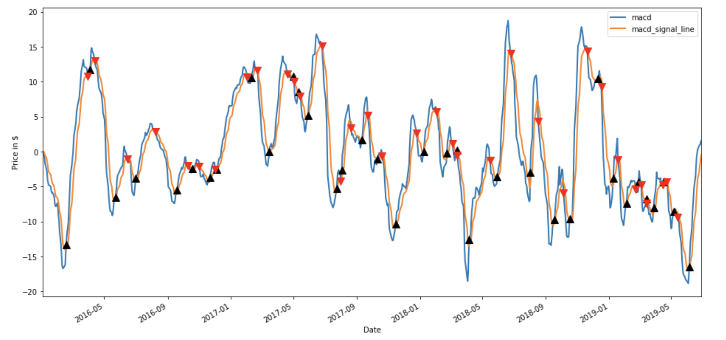
Moving Average Convergence Divergence
MACD: 12-day EMA – 26-day EMA
Signal: 9-day EMA of the MACD
Crossover: MACD – Signal
Buy Signal- When MACD crosses above
Signal line
Sell Signal- When MACD crosses below
Signal line

Slide 25
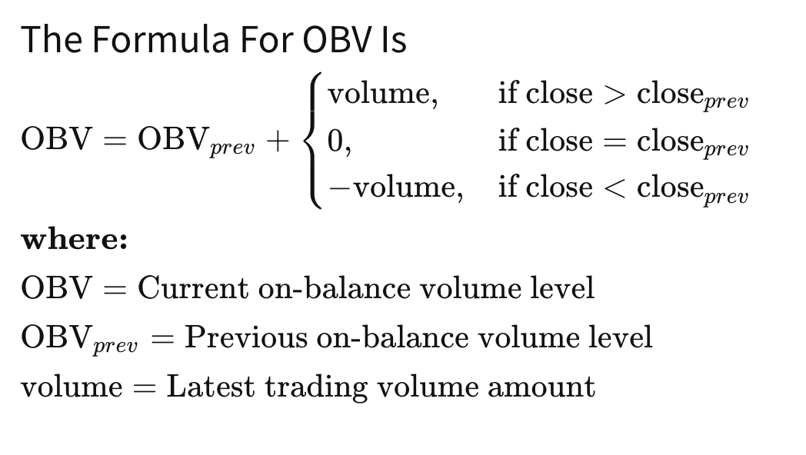
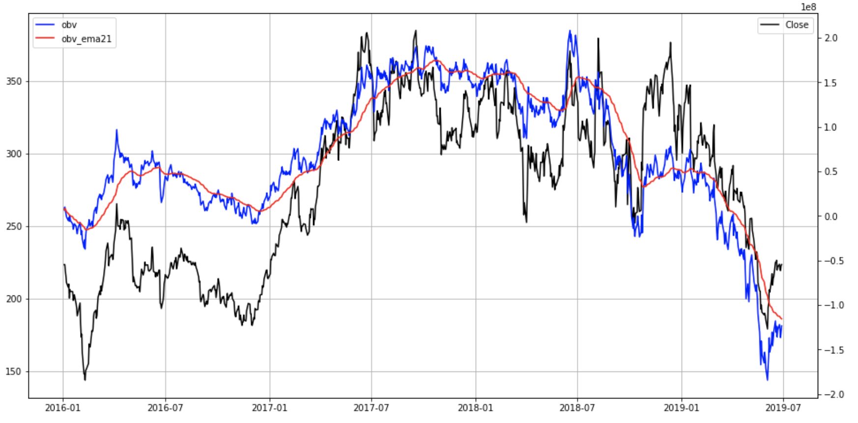
MACD + OBV (On-Balance Volume)
Volume and price rise are directly
proportional

Slide 26
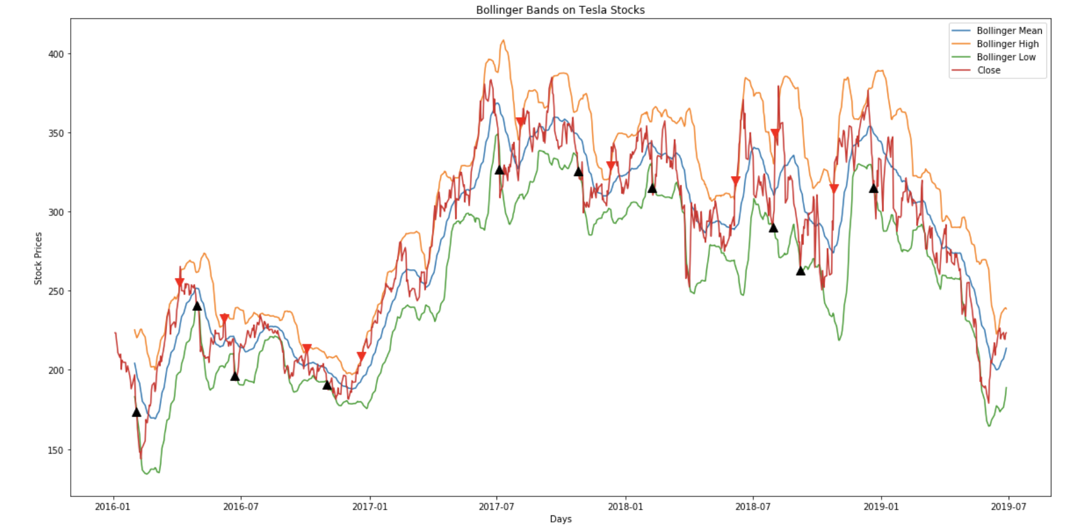
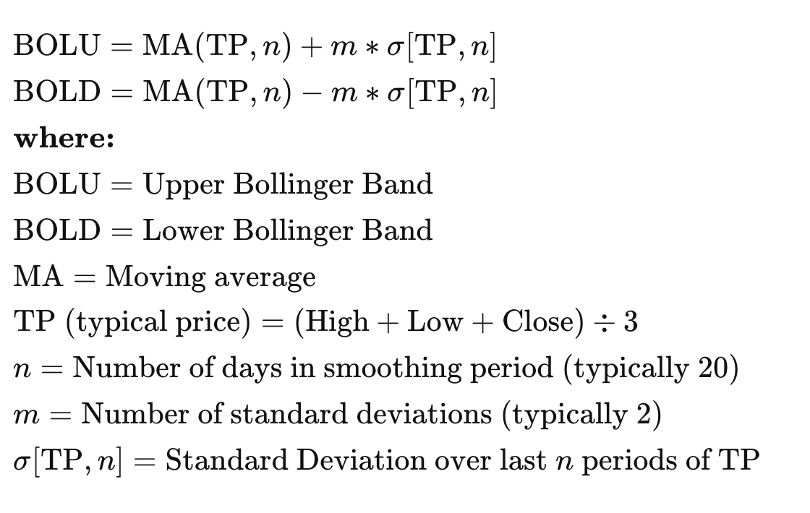
Bollinger Bands
Trend and Volatility Indicator
The closer the prices move to the
upper band, the more overbought
the market, and the closer the
prices move to the lower band,
the more oversold the market.

Slide 27
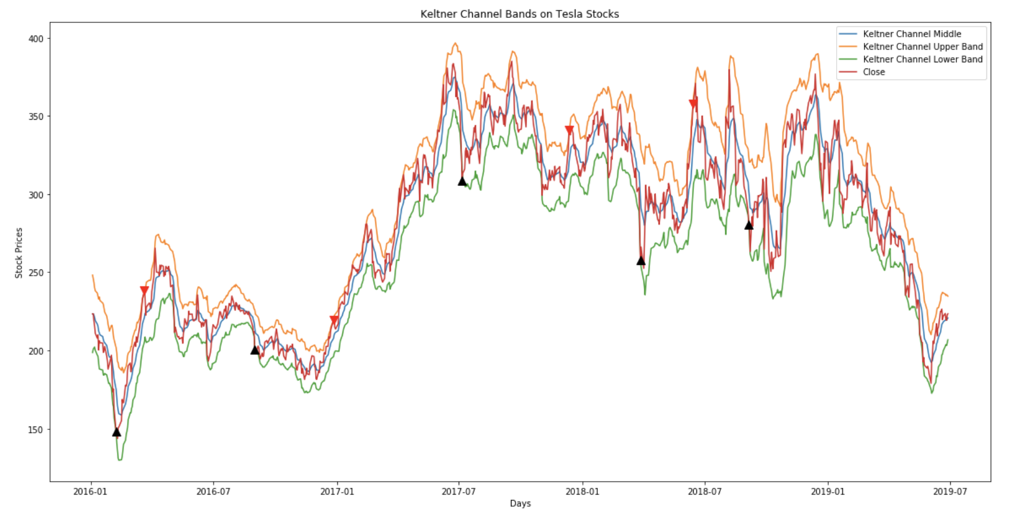
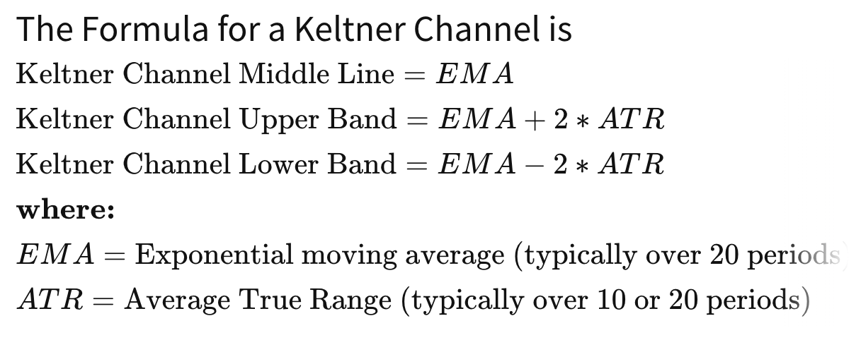
Keltner Channel
Volatility based technical indicator
The upper and lower bands are
typically set two times the ATR
above and below the EMA,
although the multiplier can
also be adjusted based on personal
preference.

Slide 28
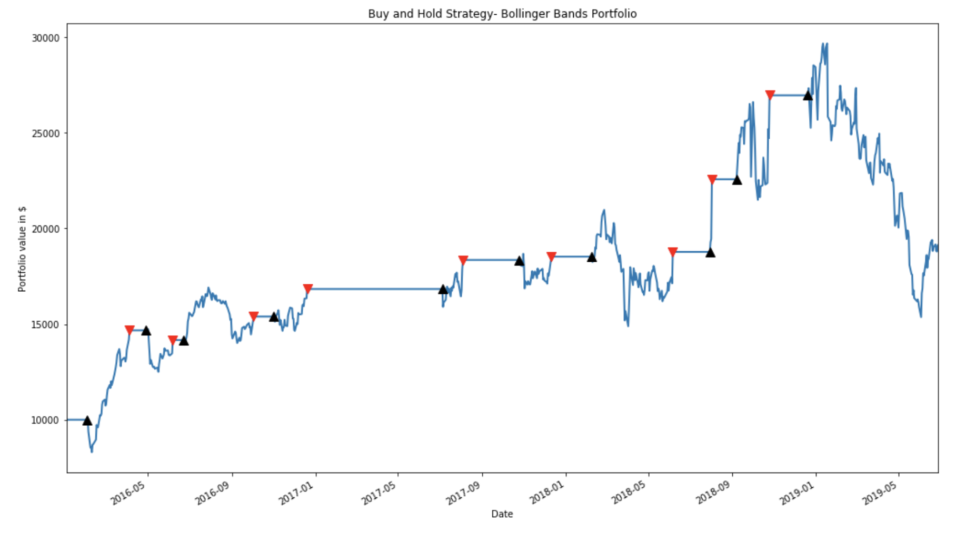
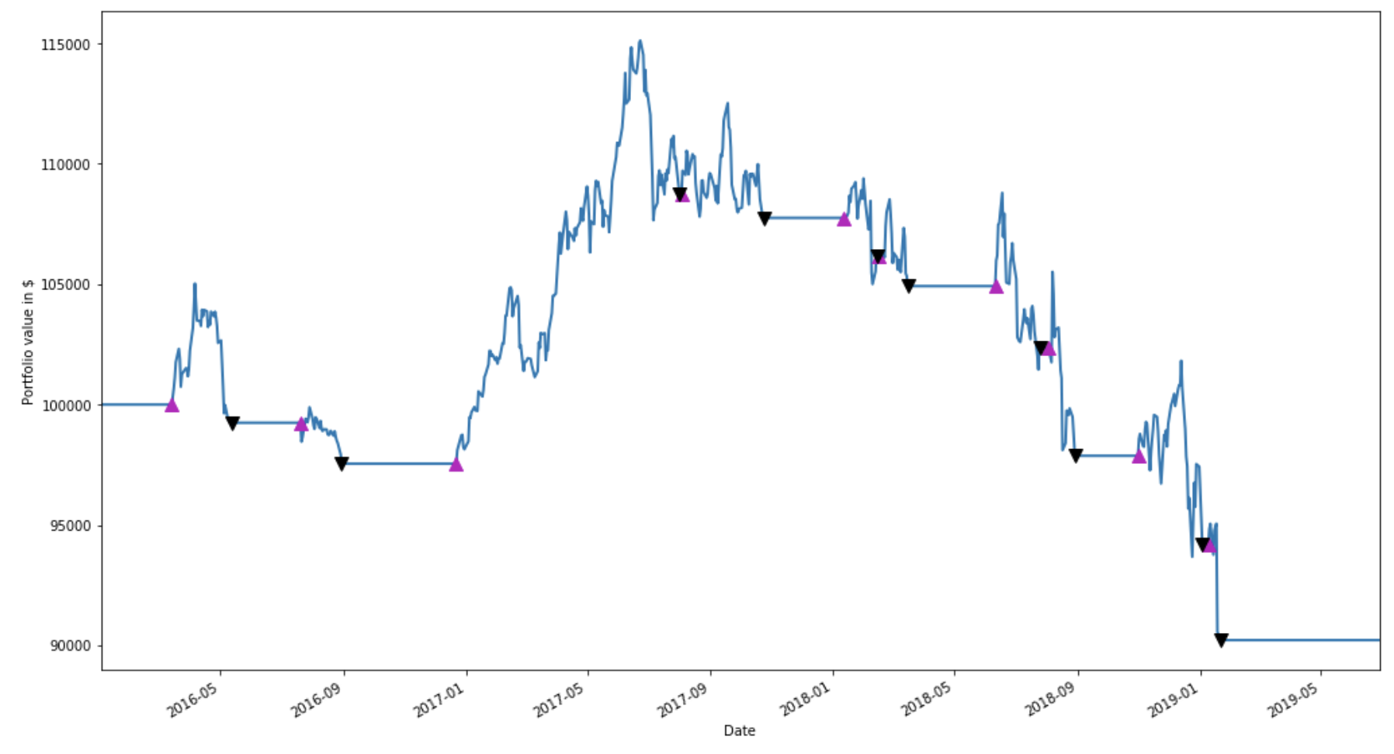
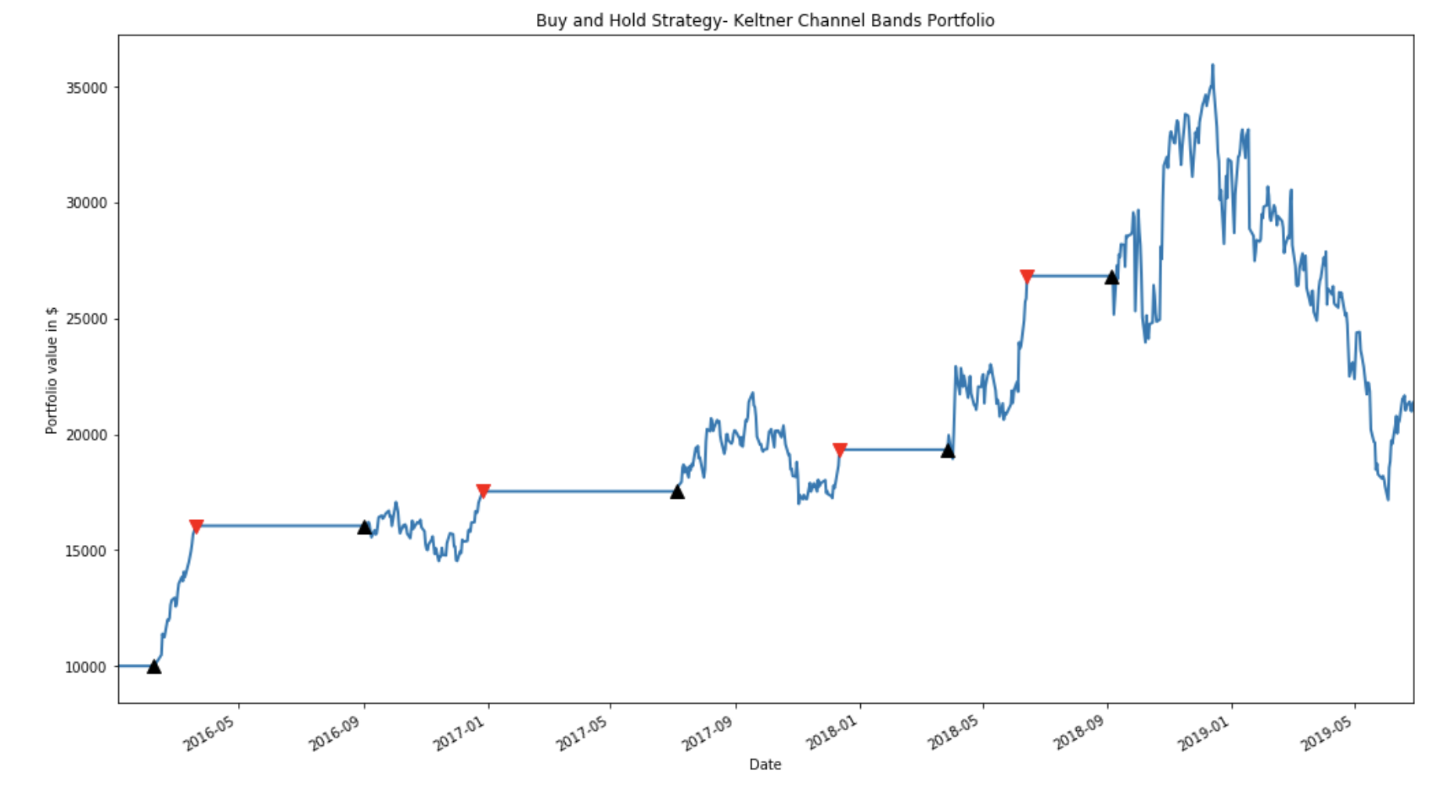
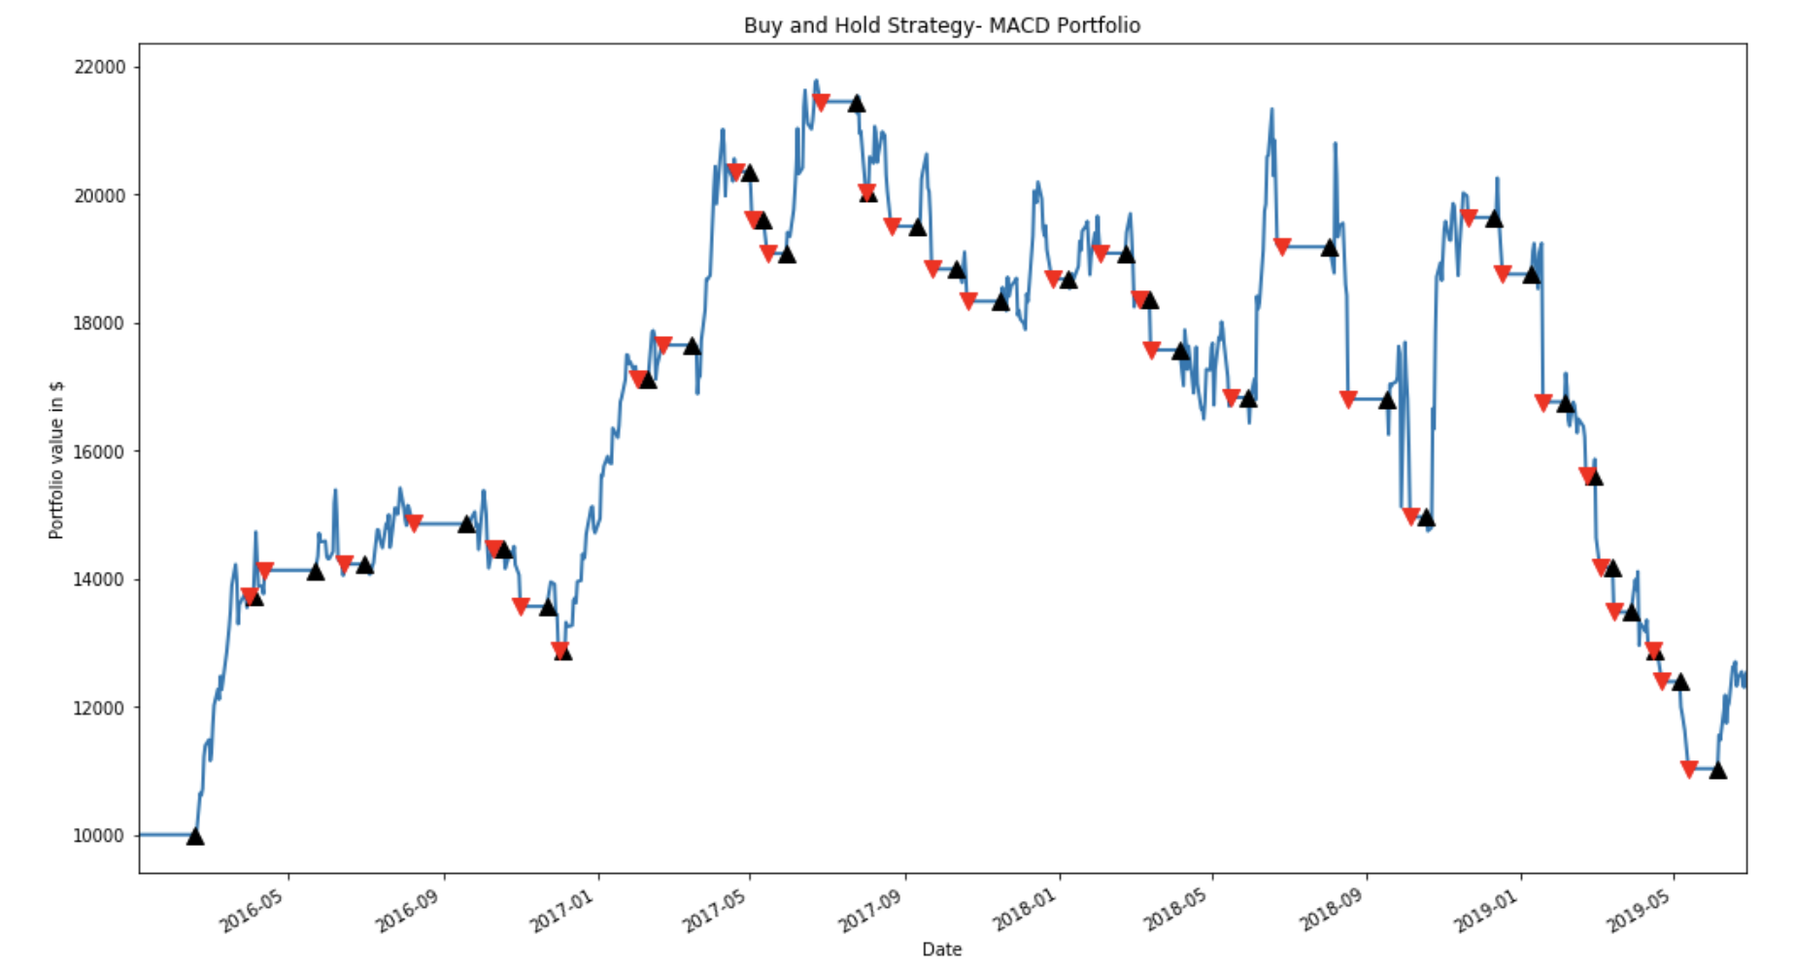
Bollinger
Bands
On Balance
Volume
Keltner
Channel
MACD

Slide 29
RISK METRICS COMPARISON
 | MACD | MACD-OBV | Bollinger Bands | Keltner Channel
Total returns | 12536.3$ | 8670.6$ | 19149.7 | 21391.3$
Sharpe Ratio | 0.36 | -0.34 | 0.69 | 0.79

Slide 31
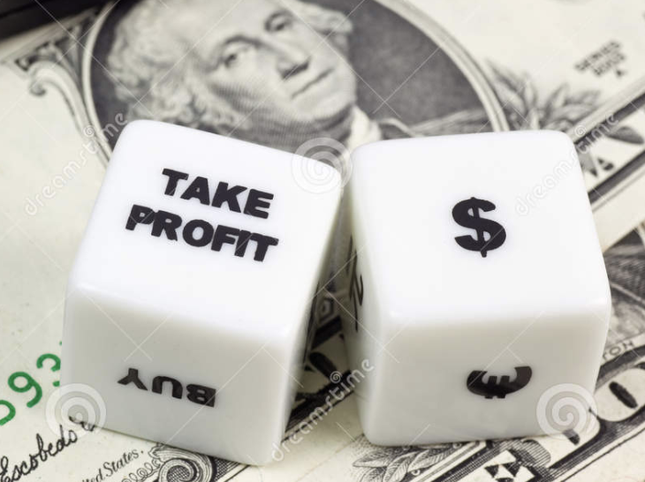
Risk Management Strategies
Keltner Channel Long-Only Strategy
Risk Management
Investment = 10,000$
 | Basic Strategy | Take-Profit
Total returns | 21391.3$ | 19794.7$
Sharpe Ratio | 0.79 | 1.11

